Slide 1
Guidelines
Text must be written in English.
Except for opening slide, only 10 slides are allowed.
Criteria | Maximum Points
Clear Presentation + Introduction | 10
Direct Question Answering | 10
Dataset Explanation | 7
Current Approach | 7
Improvements + Results | 18
Code Questions | 15
Algorithms (PCA, Wav2Vec2, etc..) | 18
Open Questions & Future Work | 15

Slide 2
Language Recognition using X-Vector and TDNN
Gabriel Dunaevsky, 208407379 Idan Kaminetsky, 208588392 Gal Koaz, 206260168

Slide 3
Introduction
Spoken language recognition has numerous applications in security, language acquisition, speech treatment, customer service, and virtual assistants.
Problem and motivation for our work:
Address methods to improve x-vector and other embedding models.
Deal with common languages which are not English.
Create a better model with less data.
Notes:
Gabi

Slide 4
Introduction
We took an existing language recognition model.
We tried to improve it with several methods
Architecture and data changes:
Cleaning audio methods
Grid Search for Hyperparameters
Intermediate layers
Funnel structure
Fine tunning using data augmentations
Notes:
Gabi

Slide 5
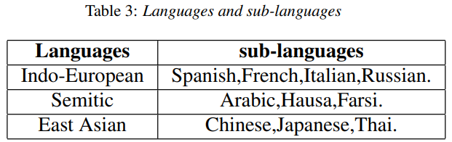
Dataset
10 languages from 3 family languages from Common-Voice Dataset.
We chose the minimum number of voice segments that we had among these 10 languages, which was 994 segments so totally we are working with 9940 voice segments. We created Balanced data for Avoiding Bias, Accurate Representation, Reliable Evaluation, Improved Generalization, and Better Decision Making.
Process:
1. Cleaning the data.
2. Data augmentation.
Notes:
Gabi

Slide 6
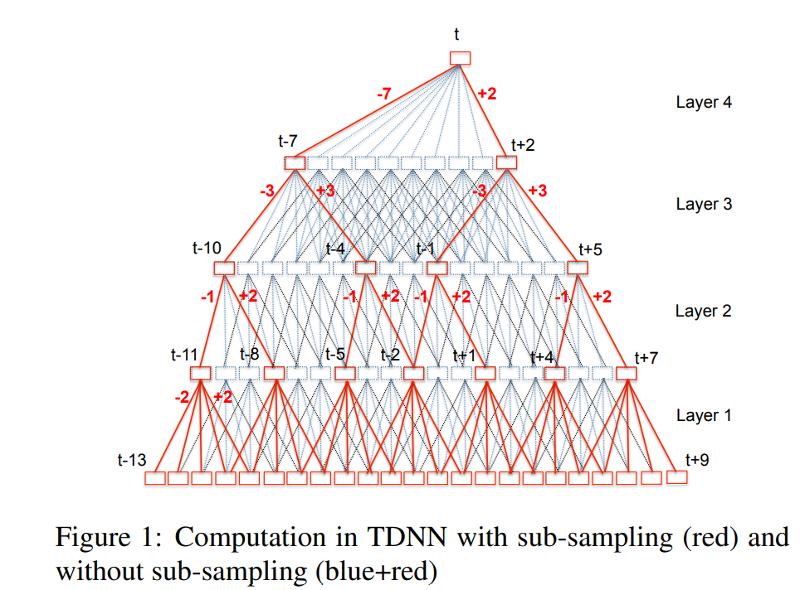
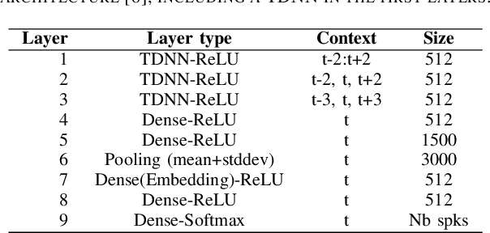
Algorithms and Methods
TDNN - Time delay neural network
X Vector
Grid-Search
Notes:
Idan

Slide 7
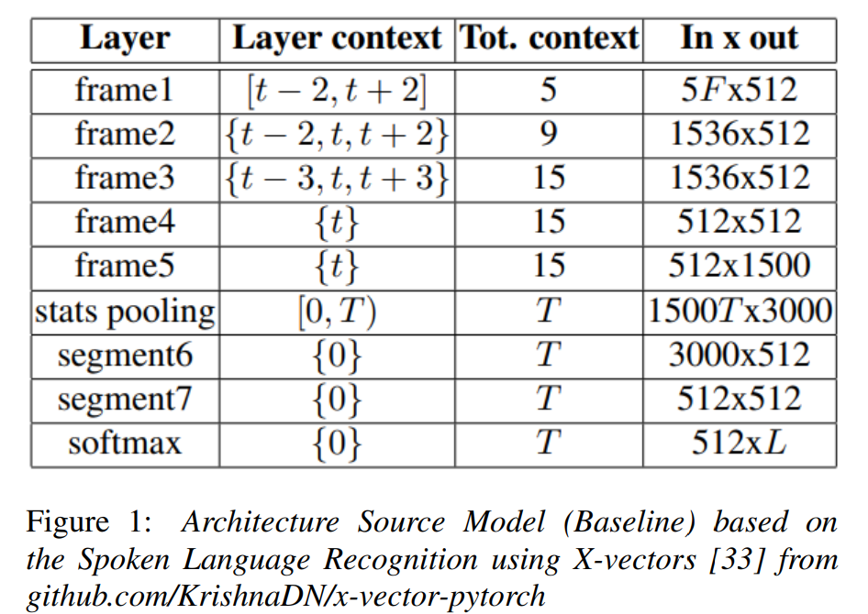
Current Approach – Baseline Model
Notes:
Idan

Slide 8
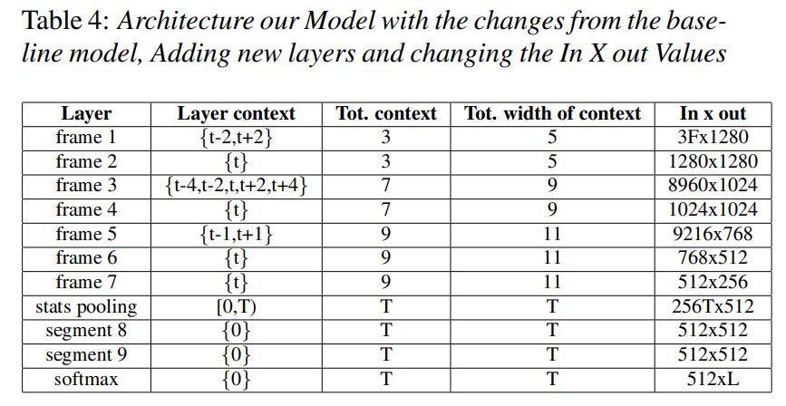
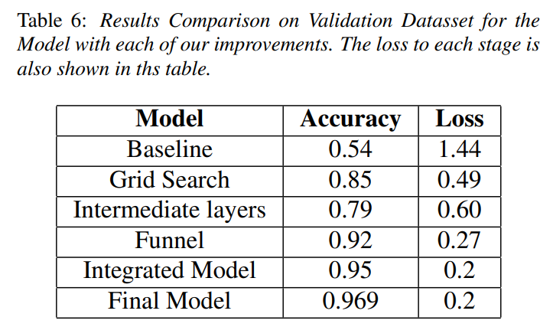
Improvements Accuracy
Framework:
Grid Search for Context Size and Dilation Hyperparameters
1x1 TDNN intermediate layers
TDNN funnel structure
Integrated Model
Final model: fine Tuning using Data Augmentations: Speed, Pitch, Noise.
Notes:
Idan - Grid Search for Context Size and Dilation Hyperparameters
Idan - 1x1 TDNN intermediate layers
Gabi - TDNN funnel structure
Gabi - Integrated Model
Gal - Fine Tuning using Data Augmentations

Slide 9
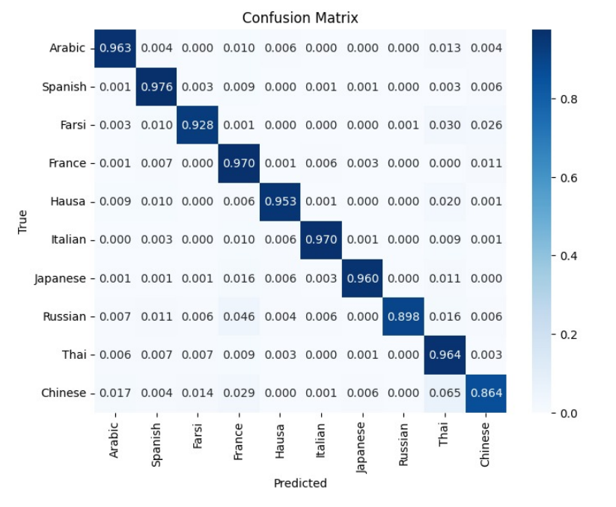
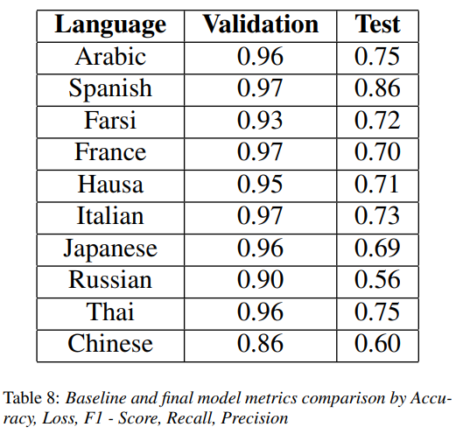
Final Model - Performance
Notes:
Gal

Slide 10
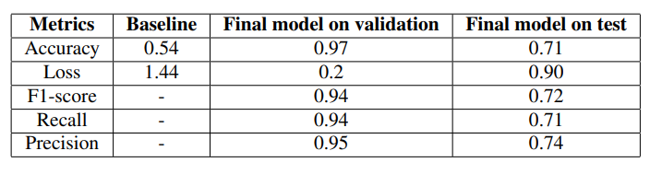
Results
Notes:
Gal RECALL: What proportion of actual positives was identified correctly? Mathematically, recall is defined as follows: Recall = TP / (TP+FN)
PRECISION: the quality of a positive prediction made by the model.
TP / (TP+FP)
F1:
It combines the precision and recall scores of a model.
The accuracy metric computes how many times a model made a correct prediction across the entire dataset.

Slide 11
Code
Data Pre-Processing - Gabi
Remove “dead” audio parts - Gal
Data augmentation creation - Gal
Grid Search – Idan
1X1 TDNN – Gabi
Funnel Structure – Gabi
Integrated Model - Idan
Fine Tuning using Data Augmentation – Gal
Results Plots - Idan
Code: https://github.com/GalKoaz/Language-Recognition
Notes:
Gal

Slide 12
Discussion – Open Questions & Future Work
Conclusions:
Methods to address embedding model improvement
Model improvement
Fewer data than the baseline model
Funnel structure made the greatest improvement
Adding 1x1 TDNN intermediate layers were the least improvements
Accuracy difference between languages
Methods which not improved the baseline model:
Noise removal
Silence parts removal
Overlap voices removal
Future works:
More augmentations methods, work with “real” data instead Common-Voice data, cross-validation, try other embedding models and ensemble methods.
Notes:
Gal

